Slide 1
Ch01 Introduction to Python
Simple review on data manipulation
Topics
Pandas.DataFrame
Data manipulation

Slide 2
Ch02 Central Tendency
Be careful with outliers!
Topics
Mean
Median
Mode

Slide 3
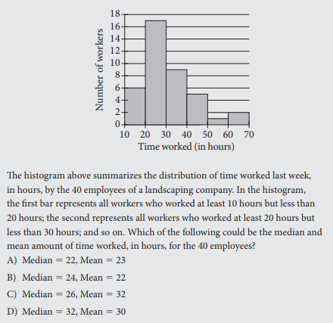
Ch02 Central Tendency

Slide 4
Ch03 Measures of variability
“What is standard deviation and variance? If stdev. is the square root of variance, why not just use variance?”
Topics
Range/Percentile
Variance/Standard Deviation
Population/Sample
Standard Error

Slide 5
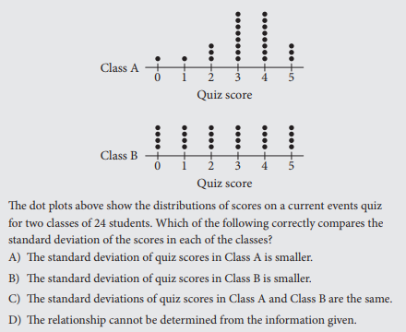
Ch03 Measures of variability

Slide 6
Ch03 Measures of variability
Standard deviation
Population vs. Sample
The only difference is N for population and N-1 for sample
When to use sample or population?
Standard error of the mean
An indication of the reliability of the (sample) mean
How to interpret standard error?

Slide 7
Ch04 Normal distribution
“Why and how to assume a normal distribution?”
Topics
Normality test
Transform data to better fit a normal distribution
Gaussian
Data fits some kind of distribution
Parametric statistical methods
Non-Gaussian
Distribution-free
Non-parametric statistical methods
When to use it?
Area of study is better represented by the median.
Very small sample size and not sure that the data is normally distributed.
Ordinal data, ranked data, or with outliers that cannot be removed.

Slide 8
Ch04 Normal distribution
Normality Test
Why test normality?
Visual check
histogram
qqplot
Statistical check
shapiro()
normaltest()
anderson()
For statistical check,
Null hypothesis: the data are normally distributed.
p ≤ alpha : reject null hypothesis
p > alpha : cannot reject null hypothesis

Slide 9
Ch05 Standardization and z-score
“You got 42 out of 200 on Stat and 65 out of 100 on Bio. On which exam did you do better?”
Topics
standardization
z-score
significance level
confidence interval
Standardization
Involves rescaling the distribution of values so that the mean of observed values is 0 and the stdev. is 1.
Assumes that the observations fit a Gaussian dist. with well behaved mean and stdev.
Not the same as normalization

Slide 10
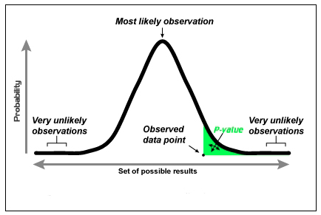
Ch05 Standardization and z-score
https://www.packtpub.com/mapt/book/big_data_and_business_intelligence/9781784390150/2/ch02lvl1sec15/a-p-value
https://www.quora.com/Why-is-a-99-confidence-level-wider-when-constructing-confidence-intervals

Slide 11
Ch06 Covariance
“How well sample statistics generalize to the larger population then?”
Topics
Covariance
Pearson’s correlation
Spearman’s correlation
Variance
The sign tells something, whereas the magnitude, hard to interpret.
When 0, independent.
Correlation coefficient
Pearson’s r: linear relationship
Spearman’s r: both linear and non-linear relationship

Slide 12
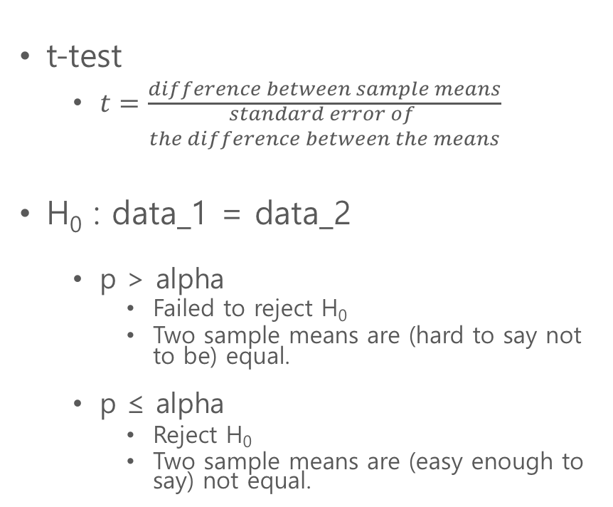
Ch07 t-test
“Is this sample mean equal to the population mean?”
“Is there a difference between the two sample means?”
Topics
Student’s t-test
t-value
p-value
t-test
$t=\frac{difference between sample means}{\begin{aligned}standard error of \\ the difference between the means\end{aligned}}$
H₀ : data_1 = data_2
p > alpha
Failed to reject H₀
Two sample means are (hard to say not to be) equal.
p ≤ alpha
Reject H₀
Two sample means are (easy enough to say) not equal.

Slide 13
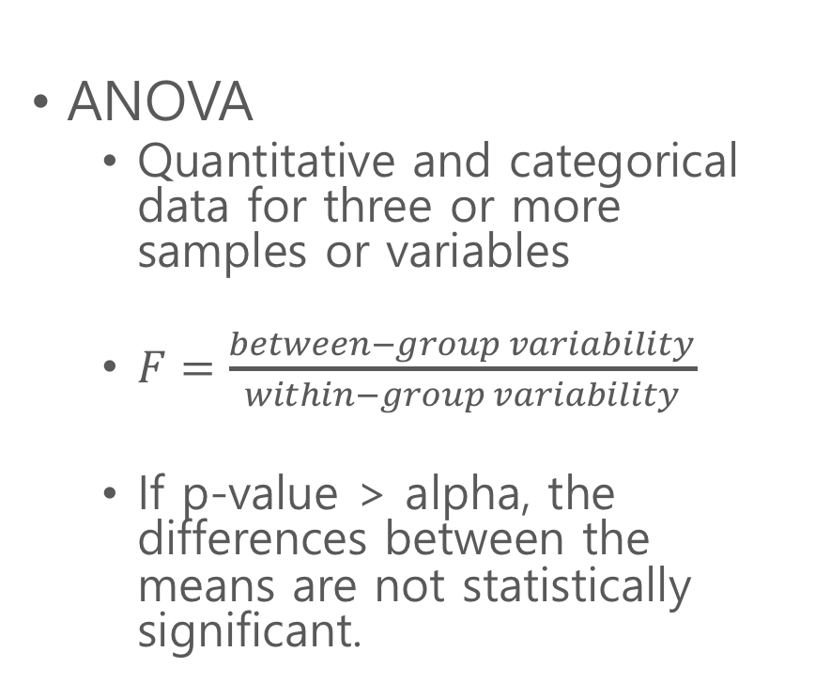
Ch08 one-way ANOVA
“How to compare more than two sample groups?”
Topics
F-test
ANOVA
Quantitative and categorical data for three or more samples or variables
$F=\frac{between−group variability}{within−group variability}$
If p-value > alpha, the differences between the means are not statistically significant.

Slide 14
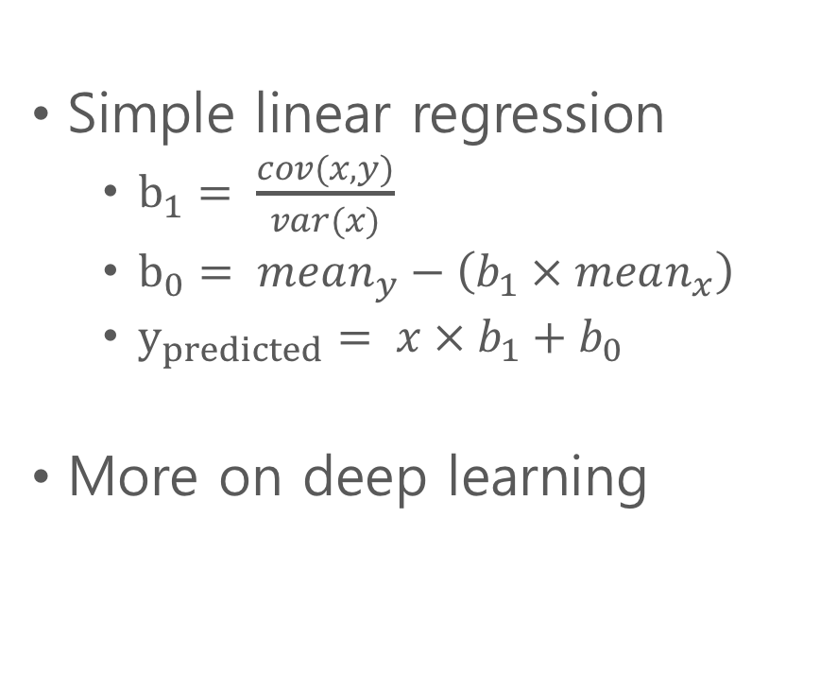
Ch09 Regression
“If correlation tells the relationship between variables, if any, then why regression?”
Topics
Prediction
Independent/dependent variables
Simple linear regression
$b_{1}= \frac{cov(x,y)}{var(x)}$
$b_{0}= mean_{y}−\left(b_{1} × mean_{x}\right)$
$y_{predicted}= x × b_{1}+b_{0}$
More on deep learning

Slide 15
Ch10 chi-square test (of independence)
“What if data are not so good, not normal, even distribution-free?”
Topics
Categorical data analysis
Independence
Contingency table
Non-parametric statistics
Useful when you have two categorical data
Categories must be filled (non-zeroes).
General rule says categories with less than 5 should be avoided.

Slide 16
Ch11 Data reduction
“Can we trust participants’ answers on a survey?”
”What more can we infer from the answers?”
Topics
PCA
Factor analysis
PCA
Data preprocessing
To speed up the learning algorithm by reducing input dimension.
For data visualization.

Slide 17
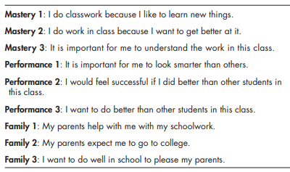
Ch11 Data reduction
Factor Analysis

